Slide 1

SPORTSNEWS24X7

Slide 2
HOME PAGE
Sportsnews24x7 is a renowned sports betting website that provides a thrilling environment for both bettors and sports fans. Sportsnews24x7 is a go-to place for individuals looking for an immersive and satisfying betting experience because of its user-friendly interface, a wide choice of sports coverage, and competitive odds. Users can explore a variety of popular sports, such as football, basketball, tennis, cricket, and more, at Sportsnews24x7. The website ensures that customers never miss their favorite matches or betting opportunities by offering thorough coverage of key leagues, tournaments, and events from across the world. The dedication to openness and fair play displayed by Sportsnews24x7 is one of its most notable qualities. To protect user information and provide a secure environment for betting, the website uses cutting-edge security features and encryption techniques. Additionally, it follows stringent guidelines and encourages responsible gaming, giving all consumers a safe and enjoyable betting experience.

Slide 3

LATEST NEWS
Best Online Cricket ID is a historic achievement felt throughout the cricketing community. Fans and professionals alike are hailing the players’ extraordinary abilities, praising their technique, focus, and sheer brilliance on the pitch. The cricketing community has been stunned, applauding this achievement as proof of the human spirit’s limitless potential and relentless quest for excellence. The significance of this record goes beyond the player’s personal success. Best Online Cricket ID inspiration to aspiring cricketers all over the world, demonstrating that incredible feats are possible with skill, hard effort, and steadfast dedication.
https://sportsnews24x7.in/category/latest-news/

Slide 4

CRICKET NEWS
Sportsnews24x7, we offer you the ultimate Reddy Anna Book for cricket betting and online sports betting. With our secure and reliable platform, you can immerse yourself in the exciting world of sports wagering while enjoying the convenience of online betting. Obtaining your Reddy Anna Book for cricket betting through Sportsnews24x7 is simple and hassle-free. We prioritize your safety and ensure that your personal information is protected at all times. Our platform is equipped with state-of-the-art security measures, giving you peace of mind while placing your bets. With your online ID, you gain access to a wide range of sports betting options, including cricket.
https://sportsnews24x7.in/category/cricket-news/

Slide 5

BETTING ID
At Sportsnews24x7, we offer you a convenient and secure online ID for cricket betting and Online ID Cricket Betting. With our user-friendly platform, you can engage in thrilling sports wagering experiences from the comfort of your own home. Obtaining your Cricket Betting for cricket betting through Sportsnews24x7 is a seamless process. Our platform ensures the protection of your personal information and provides a secure environment for your online transactions. You can enjoy peace of mind while exploring various betting options and placing your bets. you gain access to a wide array of sports betting opportunities, including cricket. From international matches to domestic leagues, we cover them all, offering a comprehensive range of betting markets.
https://sportsnews24x7.in/category/betting-id/

Slide 6

MATCH PREDICTION
Sportsnews24x7 is your ultimate destination for accurate Cricket Match Prediction. With our team of experienced analysts and cricket experts, we provide insightful and reliable predictions to enhance your cricketing experience. At Sportsnews24x7, we understand the excitement and thrill of cricket match predictions. Our experts meticulously analyze various factors, including team form, player performances, pitch conditions, head-to-head records, and other relevant statistics.
https://sportsnews24x7.in/category/ipl-2023/match-prediction/

Slide 7

ANALYSIS
Our team of experienced Best Cricket Analysis Site and journalists bring their expertise and love for the game to provide you with valuable insights. From match previews and post-match analysis to player performance evaluations and team strategies, we leave no stone unturned in unraveling the intricacies of the game. We pride ourselves on our commitment to accuracy, reliability, and timely updates. Our dedicated team works tirelessly to gather the latest news, and statistics, and match data, ensuring that our analysis is up-to-date and on point.
https://sportsnews24x7.in/category/analysis/

Slide 8

IPL
Sportsnews24x7 is pleased to introduce the Mahadev Cricket ID, your gateway to an exhilarating cricket betting experience. As part of our platform, we offer a secure and reliable for avid cricket enthusiasts like you. From international matches to domestic tournaments, our platform covers an extensive array of cricket events, ensuring there is never a shortage of thrilling betting opportunities. We prioritize the security of your personal information and transactions, providing a safe environment for your betting activities. Rest assured that your privacy is protected as you engage in the exciting world of online cricket betting. At Sportsnews24x7, we understand the importance of informed betting decisions.
https://sportsnews24x7.in/category/latest-news/ipl/

Slide 9

IPL 2021
Sportsnews24x7 presents the highly anticipated book, “Reddy Anna” by Anna Reddy. Immerse yourself in this captivating literary masterpiece, where Reddy Anna’s extraordinary journey unfolds on the pages, captivating readers with its gripping narrative and thought-provoking themes. This season, the IPL will feature eight high-powered franchise teams comprised of a galaxy of cricketing superstars from around the world. IPL 2021 becomes a battleground where legends meet and young talents make their mark, with each squad carefully designed to find a mix between experience and youthful excitement. Prepare for a cricketing feast unlike any other. Expect stadiums to vibrate with the loud roars of ardent supporters rallying behind their favorite clubs.
https://sportsnews24x7.in/category/latest-news/ipl-2021/

Slide 10
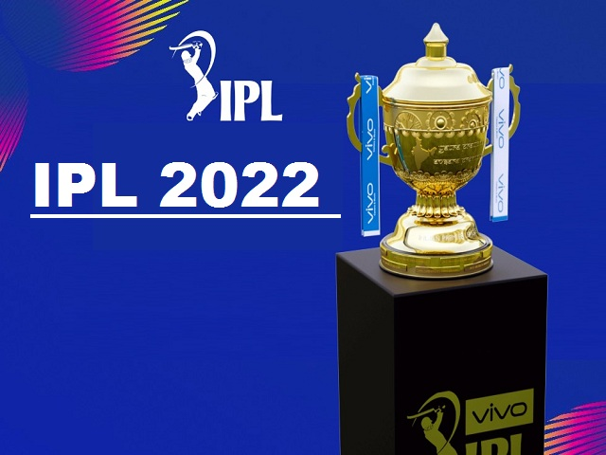
IPL 2022
Sportsnews24x7 is excited to introduce the Reddy Anna Online Book ID, granting you exclusive access to the captivating literary world of “Reddy Anna” by Anna Reddy. With this unique Book ID, you can enjoy the convenience of online reading and delve into the pages of this extraordinary book. Our user-friendly platform ensures a hassle-free experience, allowing you to access and enjoy “Reddy Anna” anytime, anywhere. Immerse yourself in Anna Reddy’s mesmerizing storytelling as you journey alongside the unforgettable protagonist, experiencing their triumphs, challenges, and personal growth. This online Book ID opens the door to a literary adventure that will touch your heart, expand your imagination, and leave you pondering life’s profound questions.
https://sportsnews24x7.in/category/latest-news/ipl-2022/

Slide 11
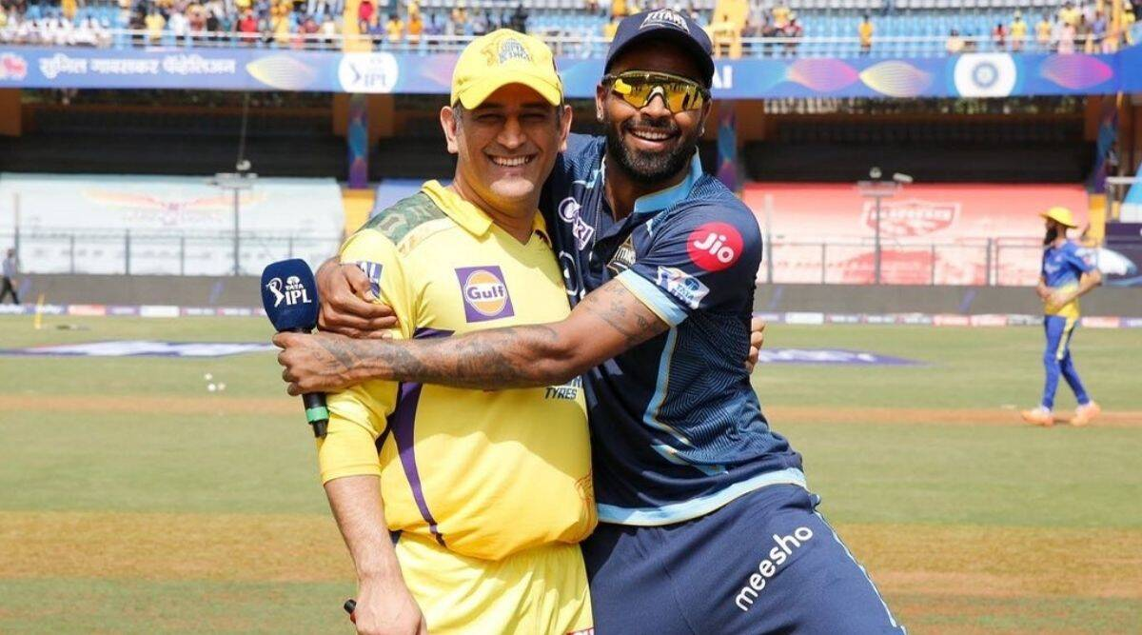
IPL 2023
The Reddy Anna Book ID is your passport to a captivating literary journey. Immerse yourself in the pages of “Reddy Anna,” a compelling book that takes you on an extraordinary adventure. Authored by a talented writer, this book delves into the life of Reddy Anna, a charismatic and enigmatic protagonist who navigates through trials, triumphs, and personal growth. Booking ID gains exclusive access to this literary masterpiece. Explore the depths of the story, unveiling its rich characters, intricate plotlines, and thought-provoking themes. Engage in the author’s vivid storytelling, as every page unfolds with surprises, revelations, and moments of profound reflection.
https://sportsnews24x7.in/category/ipl-2023/

